Slide 1

EMPLOYEE BUS ROUTE MANAGEMENT SYSTEM
BY:
Gayani Seelamneni
Gullapudi Kusuma Navya Suseela
Vegiraju Bhavani Mahadevi
Rishik Purakayastha
Lalit Vats
Guided By :
Rahul Tarkunde

Slide 2


CONTENTS Introduction Intended audience Scope Purpose Data Flow Diagrams Structures List of functions Non-functional Requirements Advantages Conclusion

Slide 3

INTRODUCTION
An EBMS / Employee Bus management system maintains the Bus facility provided by an organisation to its employees. It will generate reports employee based for salary deduction, route bus loading, high demand/requests.

Slide 4
Intended Audience:
This application is intended to be used by Employee.
Intended Use :
Organization’s HR/Admin

Slide 5

SCOPE
This project aims to create and develop the Employee Bus Route Management System contains an admin and users. We make the file which contains user’s Id, name and the bus route.
It allows the admin to add, modify or delete the details of the users and provide seats according to the availability. All the information about a particular user is stored in a retrievable manner.

Slide 6
PURPOSE
The purpose of this project is to manage the seats availability on various bus routes.
Admin can add/modify/delete User from the database accordingly.
The user can request to avail the transport facility or can opt out from it.

Slide 7
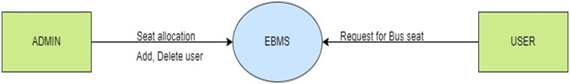
DATA FLOW DIAGRAMS
DFD Level 0 :

Slide 8
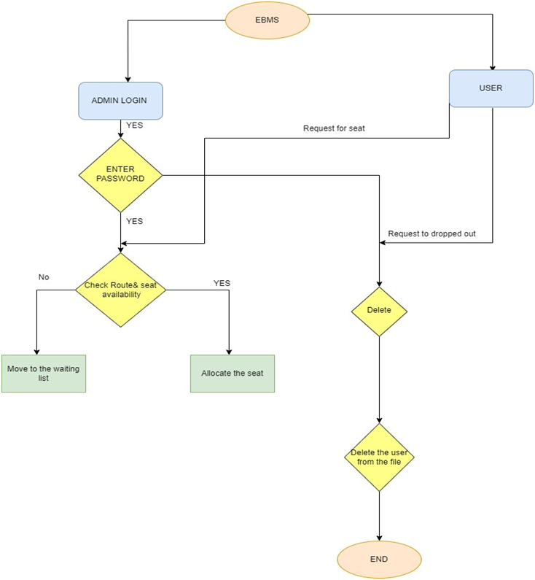
DFD LEVEL 1:

Slide 9
Structure (Emp):
typedef struct _emp_
{
int job_id;
char name[NAME_LEN];
int route;
//int route_given;
struct _emp_ * next1;
}employee;

Slide 10
Structure(Bus):
typedef struct _bus_
{
int broute;
char stops[STOP_LEN];
int total_seats;
int seats_fill;
struct _bus_ * next;
}bus;

Slide 11




List Of Functions
Admin :
void add_user()
void del_user()
void mod_user()
void see_bus()
void see_user()
void see_queue()
User :
void add_req()
void opt_req()

Slide 12
ADD USER
void add_user() :
This function is used to add data .
The data of the user consists of job id , name and bus route.
The user data can be add by the admin.
We use the csv file to store the users data.

Slide 13
DELETE USER
void del_user():
In delete user we have two 1.delete from the list
2.delete from the queue
The admin can delete the user in the queue and list as per their requirement.

Slide 14
MODIFY USER
void mod_user():
This function is user to modify the user details.
Admin has access to modify the information of the users.
User id ,name and bus route are the details of the user.

Slide 15
View Bus Routes
void see_bus():
This function is responsible to view the bus routes details.
The information of routes ,stops ,total seats and number of seats the are filled.
The Bus info is read from the bus csv file by the admin.

Slide 16
View User Details
void see_user() :
See user function used to list out all the users details present in the user csv file.
The user details has job id, name and route number.

Slide 17
View users In Queue
void see_queue():
This function is responsible to print the users information that are present in the queue .

Slide 18
User Add Request
void add_req() :
In this function the user will request the admin to get the seat allocated in their desired bus route.
The admin will allocate the seat for the user if there is vacancy in the particular bus route.
The user will be sent to the queue if the seats are filled.

Slide 19
User Opt Out Request
void opt_req() :
If the user no longer wants to avail the bus facility he sends the request to the admin.
The admin will remove the particular user details from the user’s data.

Slide 20
NON -Functional Requirements
Tools to be used :
MakeFile :It is a way of automating software building procedure and other complex tasks with dependencies.
It is a set of commands with variable names and targets to create object file and to remove them.
Valgrind :
To detect memory leaks.
Splint:
Short for Secure Programming Lint, is a programming tool for Statically checking c programs for security vulnerabilities and coding mistakes.

Slide 21

Advantages
Stress-Free Commute
Cost & Time Saving
Health Improvement
Dynamic Reporting
Protects Data & Increases Usage
Better Workplace Environment
Less Missed Workdays

Slide 22

Conclusion
The purpose of this application is to provide the effective usage of the employee bus route system and the management can easily access the data without any ambiguity.

Slide 23


